Slide 1
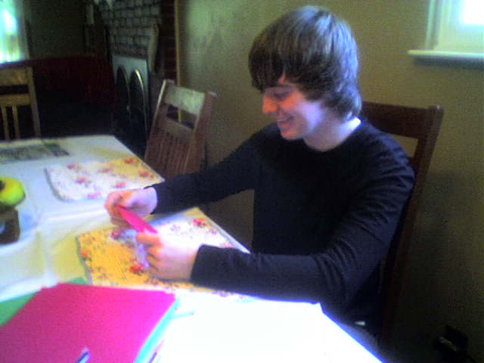
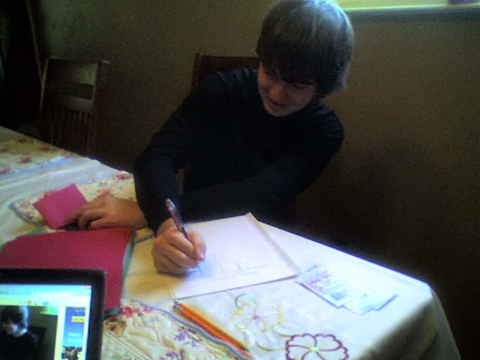
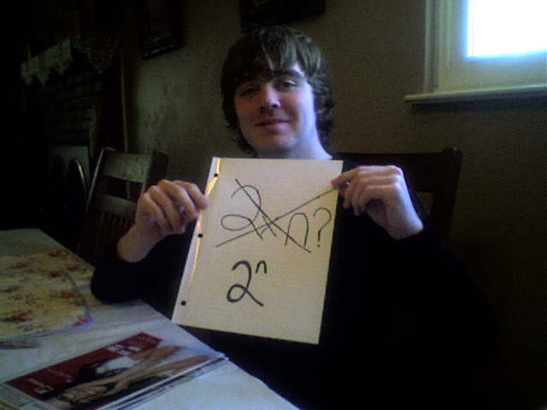
Exponential Hands-on Activity
Created and Presented by: Jennifer Weber

Slide 2
About This Activity
This activity provides students with the opportunity to explore patterns of exponential models in tables, graphs, and symbolic form. Students will be able to apply what they learn to make bigger connections to ideas such as infinity and limits.
Necessary Prior Knowledge:
General exponential equations
Experience with tables
Experience with scatter plots
Materials:
Paper (2 pieces per group)
Graph paper (2 pieces per group)
Paper Folding activity sheets (1 per student)
Optional Material:
Graphing Calculator (at least 1 per group)

Slide 3
Goals and Objectives
Goals:
The student will be able to identify patterns of exponential growth and exponential decay.
The student will be able to make accurate predictions based on real-life data.
Objectives:
Given a table of data, the student will identify the mathematical model that best represents the data with 100% accuracy.
Given a student created scatterplot and mathematical model, the student will predict future values with 100% accuracy.

Slide 4
General Classroom Arrangement
Divide the class into pairs.
Distribute the necessary materials to students (paper, graph paper, activity sheets, and, optionally, graphing calculator).
Provide outline of the activity to the students.
Outline of the Activity:
Each pair of students will be divided into two roles.
The recorder: the person who will write down the appropriate information in the provided table
The folder: the person who will follow the directions and fold the paper as necessary

Slide 5
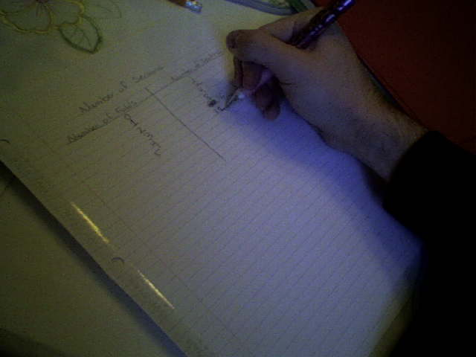
Activity 1: Creating Rectangles
Step 1:
Take an 8.5 x 11” sheet of paper.
Determine how many rectangles are created when you have zero folds.
Now fold the paper in half and determine the number of rectangles the paper has after you have made the fold.
Step 2:
Record data in the table on the activity sheet and continue in the same manner until the table is completed.
.

Slide 6
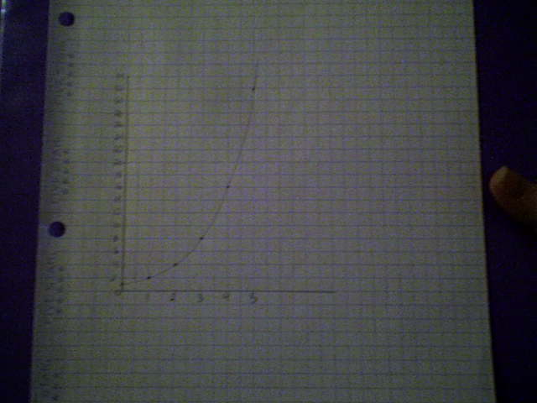
Activity 1 continued
Step 3:
Determine a mathematical model that represents this data by examining the patterns in the table.
Step 4:
Make a scatter plot of the data from the table.

Slide 7
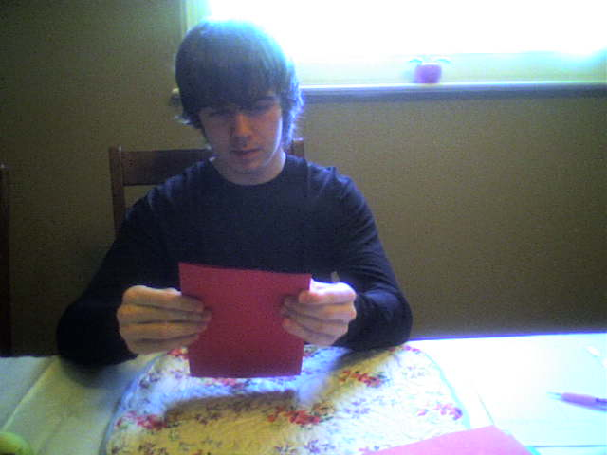
Activity 2: Area of the Smallest Rectangle
Step 1:
Suppose the dimensions of your sheet of paper are a length of 1 unit and a width of 1 unit.
Determine the area of the smallest rectangle created when you have zero folds.
Fold the 8.5 x 11” sheet of paper in half and determine the area of the smallest section after you have made the fold.
Step 2:
Record this data in the table and continue in the same manner until the table is completed.

Slide 8
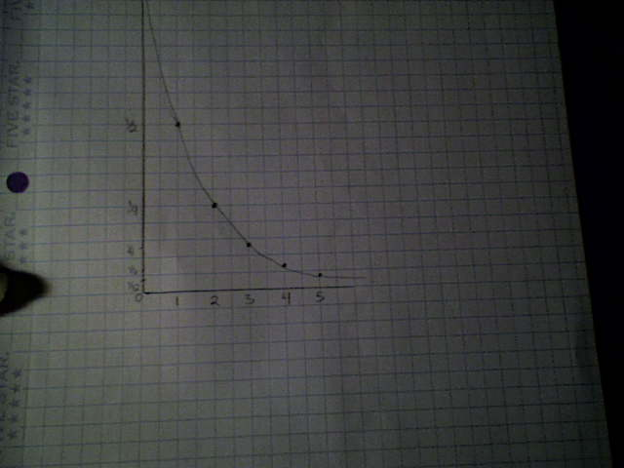
Activity 2 continued
Step 3:
Determine a mathematical model that represents this data by examining the patterns in the table.
Step 4:
Make a scatter plot of the data from the table.

Slide 9
Key Questions
What do you notice about the two graphs you created?
In Activity 1, what do you think would happen if you kept folding the paper?
What would happen if you used tissue paper instead of the paper you were given?
What would happen if the tissue paper was as large as this room? Would the values in the table approach any particular number?
In Activity 2, what do you think would happen if you kept folding the paper?
What would happen if you used tissue paper instead of the paper you were given?
What would happen if the tissue paper was as large as this room? What number do you think the values in the table would approach?

Slide 10
Works Cited
Area of smallest rectangle. (n.d.). Lesson plans. Retrieved April 29, 2012 from
http://www.pbs.org/teachers/mathline/lessonplans/pdf/hsmp/rhinos.pdf
Number of rectangles. (n.d.). Lesson plans. Retrieved April 29, 2012 from http://www.pbs.org/teachers/mathline/lessonplans/pdf/hsmp/rhinos.pdf

